Slide 1
Race Analysis
By abhi.n

Slide 2
Introduction of the Dataset The dataset provided appears to be related to motor racing events and contains detailed information about cars, teams, drivers, and race performance metrics. This data can be used to analyze race results, team strategies, car performance, and other race-related insights.

Slide 3
Key Features in the Dataset
The dataset includes the following notable columns:
Category: Classification of the car (e.g., based on performance level or class in the race).
Team: The racing team or entity managing the car.
Drivers: The individuals driving the cars.
Car: The model or type of the car.
Tyres: The tyre manufacturer or type used during the race.
Laps: The total laps completed by the car during the event.
Best LapTime: The fastest lap time achieved by the car.
Best Lap Kph: The speed (in kilometers per hour) during the best lap.
Pitstops: The total number of pitstops made during the race.
Status: The final status of the car (e.g., Finished, Retired, or Disqualified).
Hour: The specific time intervals or segments of the race.

Slide 4
Analysis Methods Data Cleaning: Missing values in columns like Car, Tyres, Best Lap Number, Best LapTime, and Best Lap Kph were filled with appropriate replacements: Text fields were filled with "Unknown."Numeric fields were filled with the median values.Data types were preserved for efficient analysis. Descriptive Statistics: Used Python's pandas library to compute summary statistics for numeric columns.Calculated key metrics like mean, median, standard deviation, and ranges for columns such as Laps, Pitstops, and Best Lap Kph. Data Visualization: Used matplotlib and seaborn to create visualizations Histograms: For understanding the distribution of numeric data.Scatter Plots: To explore relationships, e.g., Laps vs. Pitstops by Category.Bar Charts: To visualize categorical distributions, such as Status. Exploration of Relationships: Correlations between numeric variables were assessed visually.The performance of vehicles across categories (e.g., Best Lap Kph) was compared. Categorical Analysis: Unique values in Team, Drivers, Car, and Category were analyzed to understand the diversity in the dataset.

Slide 5
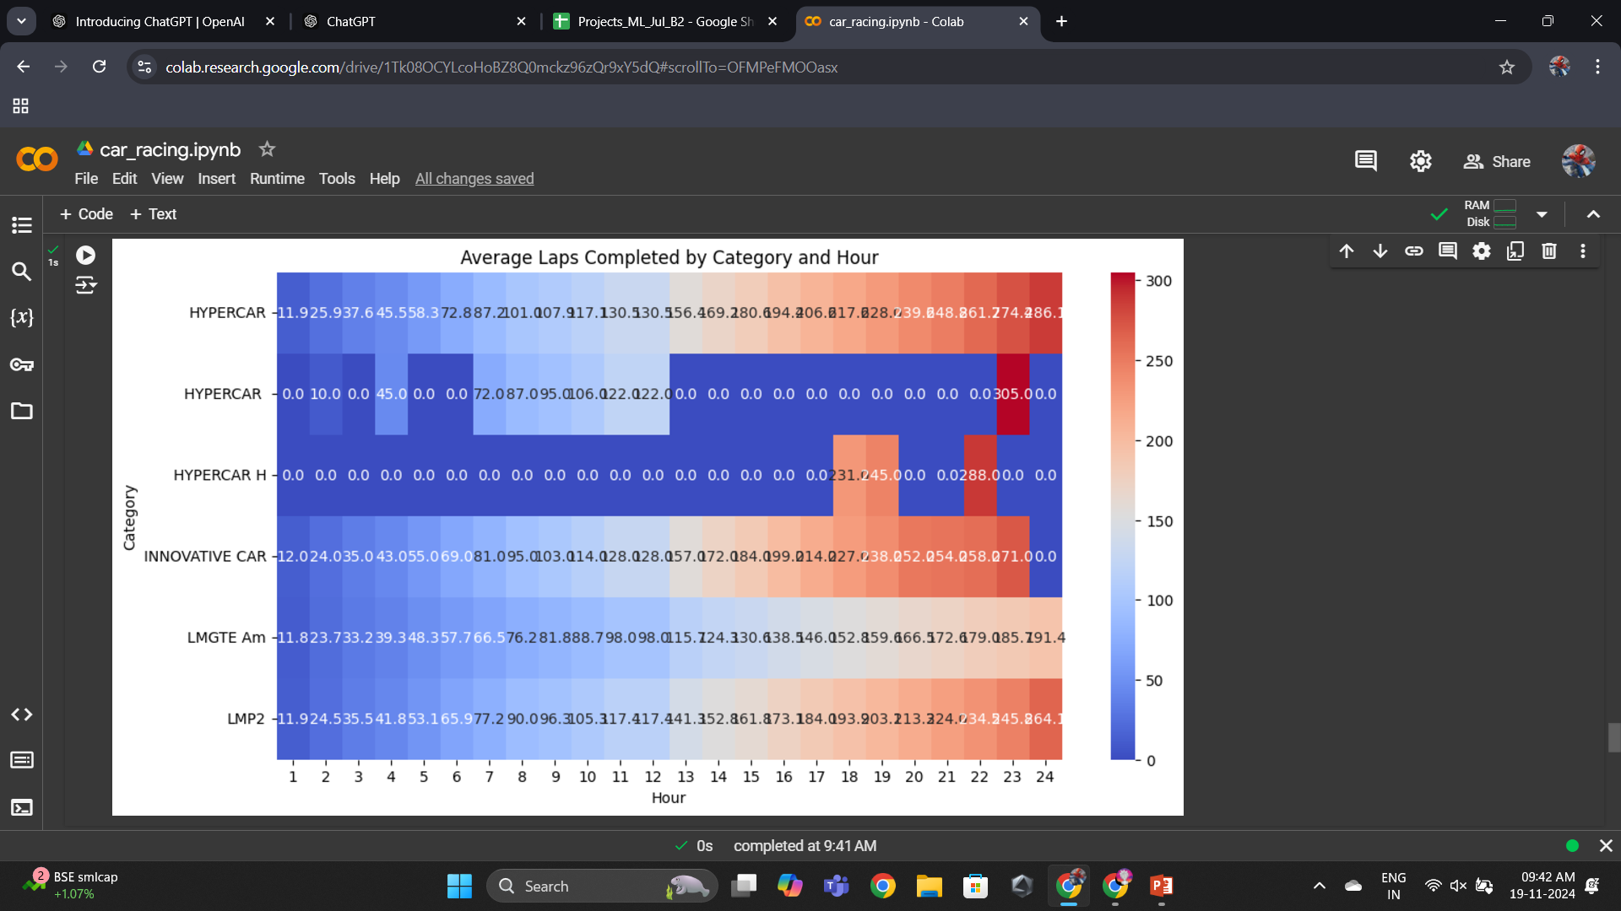
Visualizations

Slide 6
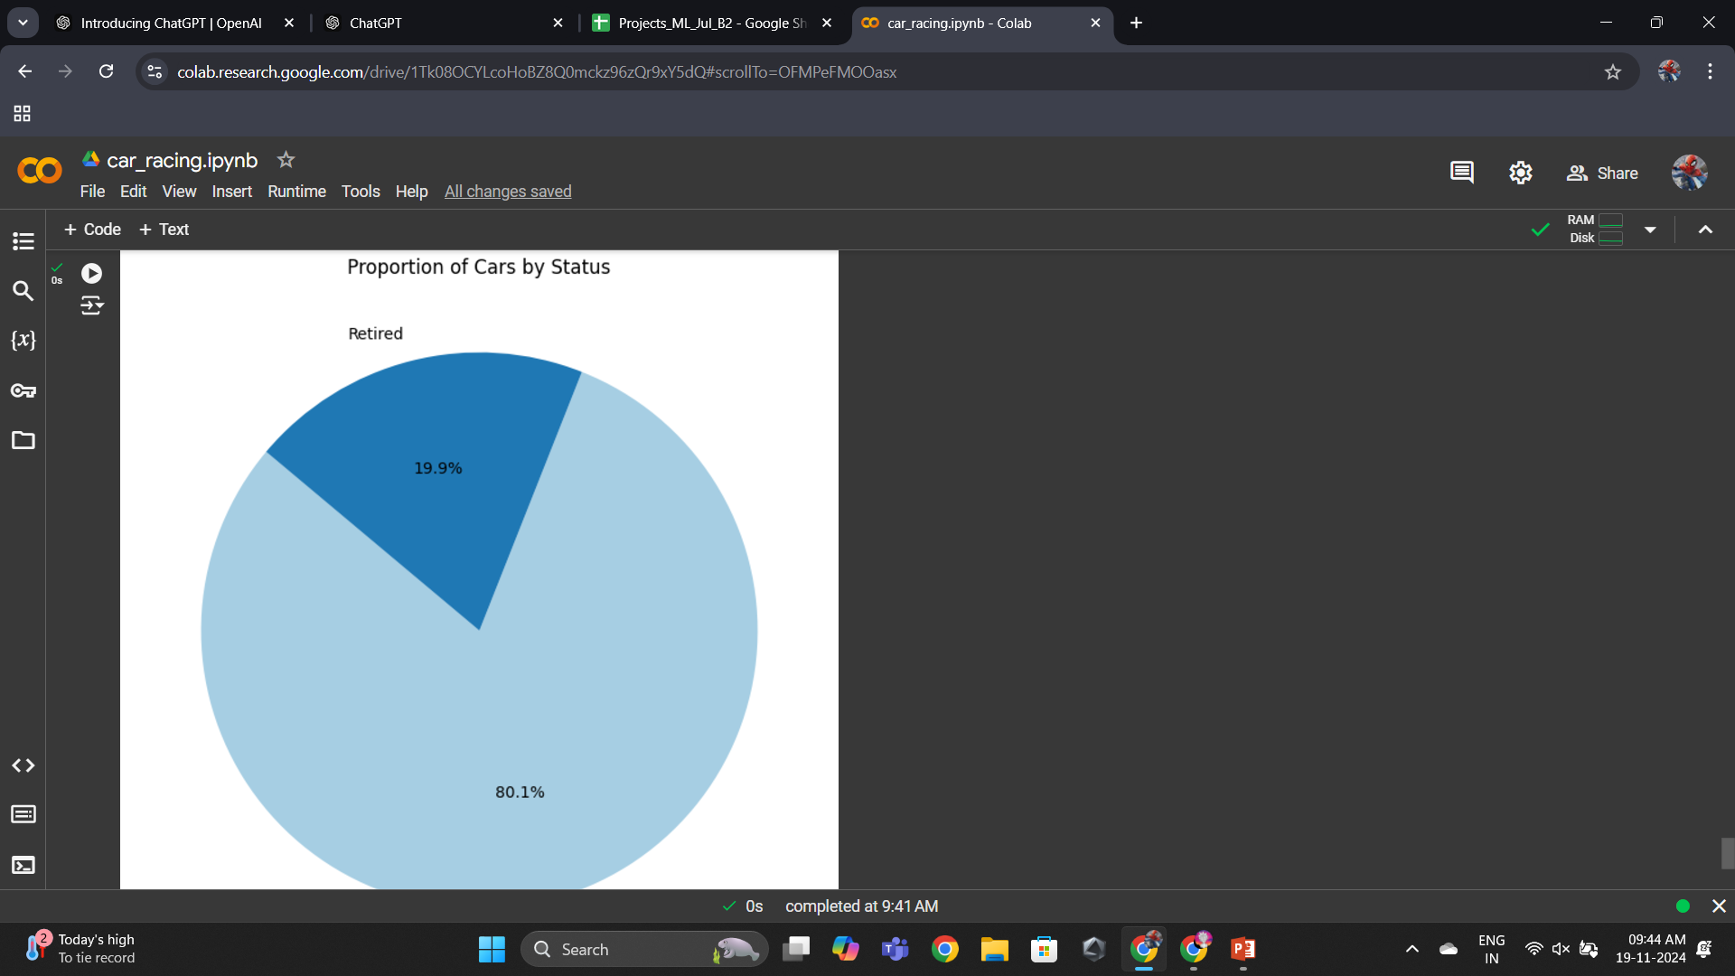

Slide 7
Findings from the Dataset Analysis 1. Overall Race Performance Laps Completed: Teams completed between 1 and 342 laps, with an average of 129 laps. The highest lap counts were achieved by teams in the HYPERCAR category, showcasing their endurance and efficiency. Best Lap Time: The fastest laps were around 3 minutes 30 seconds, reflecting the peak performance of vehicles and driver skill. Best Lap Kph: Speeds ranged from 204.1 km/h to 237 km/h, with an average of ~221.8 km/h. Teams with higher average speeds generally completed more laps, indicating the importance of maintaining consistent speed.

Slide 8
Insights 1. Team Performance Insights Laps Completed: Teams completed between 1 and 342 laps, with an average of 129 laps. Consistently high-performing teams completed significantly more laps, showcasing strong strategies and efficient car performance. Best Lap Times: The fastest lap times averaged ~3 minutes 30 seconds, suggesting exceptional coordination and vehicle capabilities. Pitstops and Strategy: On average, teams made ~12 pitstops during the race. Teams with fewer pitstops often completed fewer laps, indicating either fewer issues or less aggressive strategies.

Slide 9
2. Speed Insights
Best Lap Kph:
Speeds ranged from 204.1 km/h to 237 km/h, with an average of ~221.8 km/h.
Higher speeds correlated with better overall lap performance, especially in categories like HYPERCAR.
3. Category-Based Insights
Diversity in Categories:
The dataset includes 6 unique race categories, such as HYPERCAR and others likely representing different vehicle types and performance classes.
The HYPERCAR category showcased the highest speeds and best lap performances.
Category-Specific Strategies:
Vehicles in different categories varied significantly in lap count and pitstops, likely reflecting the differing requirements and endurance capabilities.

Slide 10
4. Driver and Team Insights
Driver Combinations:
There were 65 unique driver combinations, indicating a diverse set of strategies and skill sets.
Teams with well-balanced driver rotations likely performed better in endurance metrics.
Team Representation:
45 unique teams were part of the event, with many competing in specific categories. This suggests a competitive multi-class environment.
5. Status and Completion Insights
Status:
Most vehicles were marked as "Running," indicating successful completion or active participation.
A smaller fraction might have faced mechanical or operational issues (e.g., "Retired" or "Disqualified").
Completion Challenges:
Teams with higher pitstop counts often struggled to maintain competitive lap counts, highlighting the impact of operational delays on performance.

Slide 11
6. Competitive Benchmarks
Teams with consistent Best Lap Kph and optimized pitstop strategies consistently outperformed others in terms of total laps.
High-performing teams demonstrated a balance between endurance, speed, and operational efficiency.

Slide 12
Conclusion
Team and Vehicle Performance:
Teams that completed more laps tended to make more pitstops, likely indicating well-planned strategies balancing performance and maintenance.
The highest average speeds were observed in vehicles within the HYPERCAR category, showcasing their superior design and performance.
Race Dynamics:
The majority of vehicles were classified as "Running," indicating successful operations for most teams. Only a small fraction faced challenges.
Category-Wise Trends:
The dataset highlights variations in performance metrics (laps, speeds, pitstops) across race categories, showcasing differences in strategy and capability.
Recommendations:
Teams can analyze their Best Lap Kph and compare it against their competitors to optimize performance.
Focus on reducing pitstops without compromising performance, as this could lead to higher lap counts.

